Slide 1
Predicting Defaults on Loans

Slide 2
Our Problem
Lending is the most lucrative and risky activity most financial institutions engage in
The US housing collapse in 2008 was caused by poor risk analysis in housing loans
We must do everything in our power to find better ways to identify high-risk loans prior to loan approval, as a means of both growing and safeguarding our financial institutions
We must also ensure we do not violate fair lending laws in our analysis and approval of loan applicants

Slide 3
Our Data
Our data is anonymized loan data from an anonymous financial institution
It contains data on over 255,000 loans
It contains data on both defaulted and non-defaulted loans
The data contains 17 features

Slide 4
Our features
Features include
Age
Education
Loan to Income ratio
Debt (total) to income ratio
Marital status
Whether there is a mortgage
Whether there are dependents
Whether there is a co-signer
Income
Loan amount
Number of credit lines
Credit score
Loan term
Interest rate
Months Employed
Employment type
Loan Purpose

Slide 5
Exploratory Data Analysis
We start by looking for differences in summary statistics. A few interesting finds:
8 year difference in avg age: for defaulters, average is 36. For non defaulters, it is 44
18k median income difference: for defaulters, median is $66,566. For non defaulters, it is $84, 237
Surprisingly small credit score difference. For defaulters, average is 559. For non defaulters, it is 576
Surprisingly small debt to income difference. For defaulters, average ratio is 0.516. For non defaulters, it is 0.499

Slide 6
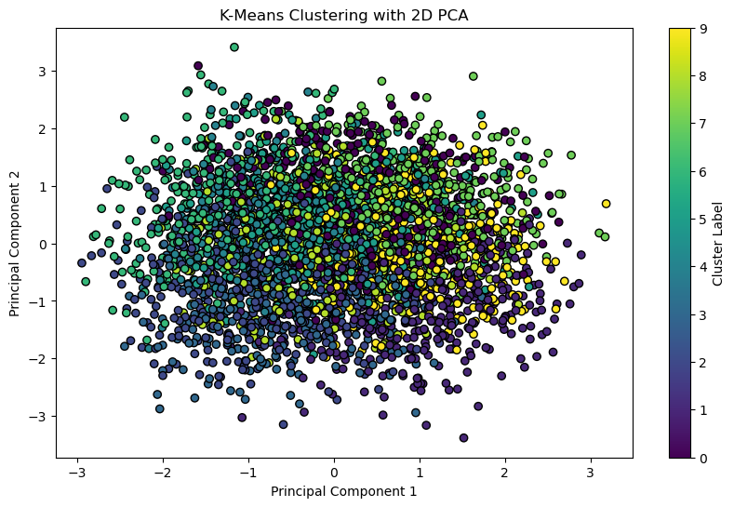
Exploratory Data Analysis (cont’d)
No useful clusters in unsupervised learning. Using K Means:

Slide 7
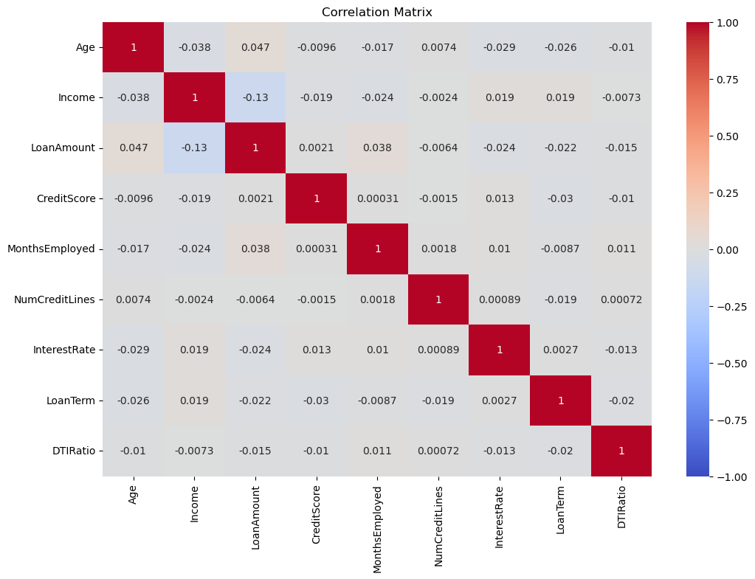

Exploratory Data Analysis (cont’d)
No strong correlation among variables by themselves. Defaulted loans (left) and Non-Defaulted Loans (right)

Slide 8
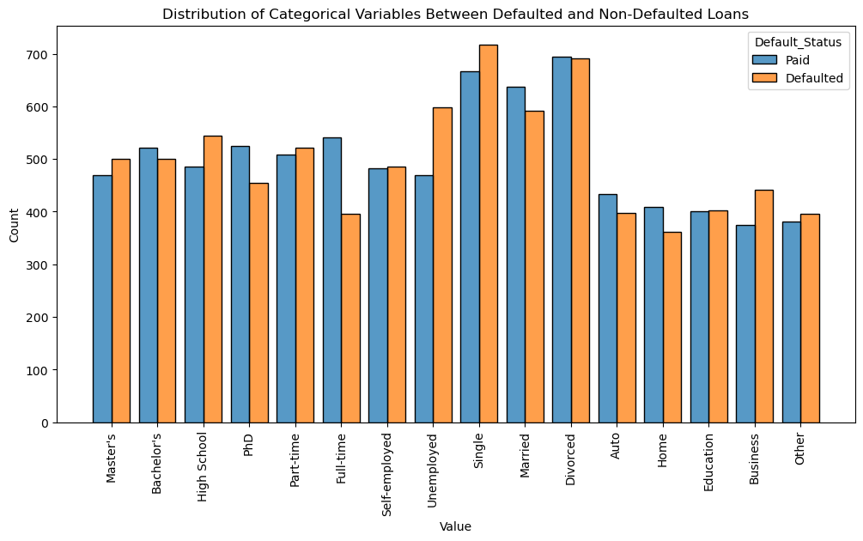
Exploratory Data Analysis (cont’d)

Slide 9
Exploratory Data Analysis (summary)
There are a few interesting statistics between those who default. Usefully, age and income seem to be rather different. Surprisingly, credit score and debt-to-income ratio do not seem to be useful.
K Means is not able to produce any distinct clusters within the data
Heat mapping does not expose any strong correlations within the data
We are able to produce a histogram which seems to show some significant initial distinctions in the data between those who have defaulted on their loans and those who do not.

Slide 10
Scaling our data
To ensure that relationships in our data are accurately captured, we need to scale our data before creating models. We must scale lower continuous variables (such as age and different ratios) to higher continuous variables (such as income and debt amount). We also encode categorical variables to allow their analysis.

Slide 11
Modeling
We must use a classification model, as we are aiming to filter loans into results of yes or no, rather than a numerical value
We are using the two metrics of ROC AUC score and recall to select our model.
We will choose between Random Forest and ADA Boost classifiers

Slide 12
Model selection
Our best model was an ADA Boost Classifier. This model, once tuned, produced an ROC AUC score of .75 and recall scores of .71 for non-defaulted loans and .65 for defaulted loans.
High ROC AUC score is indicative that the model can distinguish well between positive (defaulted) and negative (non-defaulted) classes.
High recall indicates a strong ability to correctly identify positives

Slide 13
Hyperparameters
Model: ADABoostClassifier
Learning Rate
0.5
Balances the model’s sensitivity to changing with each loan it learns from, without overadjusting
N_estimators
50
Saves computation time. 50 is the maximum number of estimators that makes a significant difference to accuracy, without wasting computation time leveraging further estimators
Random_state
1
Keeps the random state consistent in all situations where a random state is used. This allows for reproducibility

Slide 14
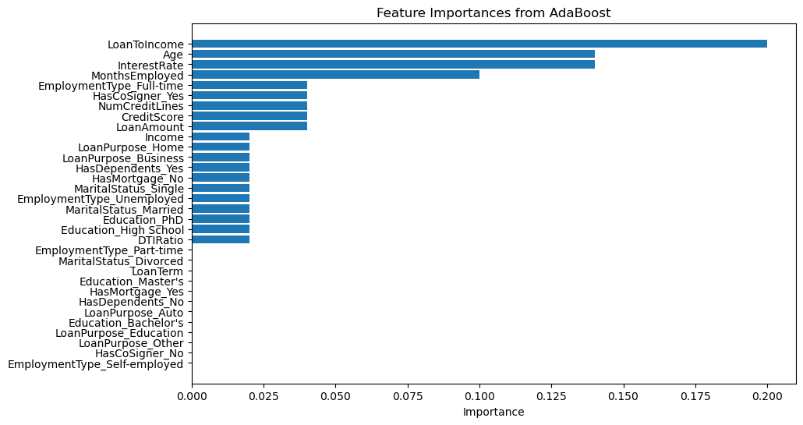
Identifying important features
In addition to the model, we must identify the factors that influence the risk for default the most. These will give us powerful, easy to use insights when approving individual loans.

Slide 15
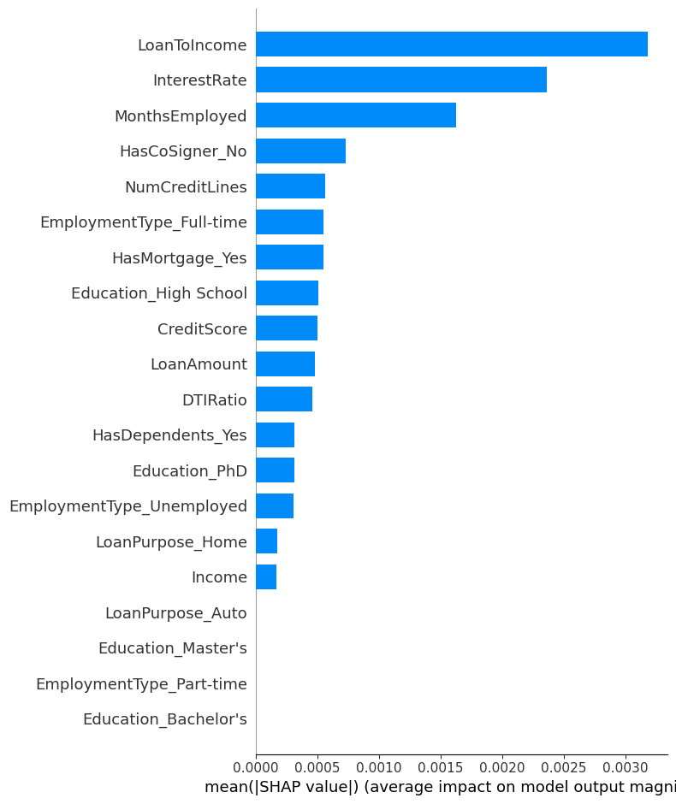
Identifying important features (SHAP)
Shap Analysis (SHapely Additive exPlanation) uses game theory to produce a more powerful and more general analysis of factors and their importance. The difference between these two is the previous feature analysis only uses a brief evaluation of how one model in one situation used features.

Slide 16
Important Legal Considerations
Fair Housing Act
Protects certain classes against discrimination in housing loans. Of concern to us, we are not permitted to use age to determine approval or denial of a loan
Equal Credit Opportunity Act
Protects certain classes against discrimination in all loans. Of concern to us, marital status is not usable as a determinant factor

Slide 17
Findings and action items
Our four most important factors in evaluating the risk of default are the ratio of the loan amount to income, age, interest rate, and duration in the applicant’s current role
Of these four, only two are usable. Age is a protected class for home loans, and interest rate is unusable because it is calculated by lenders as a reflection of risk, and is therefore calculated alongside, not independently of the loan.
The ratio of the income of the applicant to the loan amount is important, and should be calculated. Debt to income is a different ratio, and is less useful.

Slide 18
Further Research Ideas
We should continue to look at more features to identify other qualities that can be used predictively in the lending process
We should also to experiment by calculating additional ratios between continuous variables, as the simple ratio between the income and loan amount was the most useful predictor, and was not included in our initial data

